Slide 1
Delivery Routine

Slide 2
Agenda
Why Delivery Routine

Slide 3
Delivery Routine
We can’t decide or instruct APPLICTION.HANDOFF
  What values need to be picked up from the contract
  Which position in DE.O.HANDOFF the extracted values need to be written to
Information from applications other than from the contract may be required.
User may require other calculations to be performed and the result incorporated into the advice

Slide 4
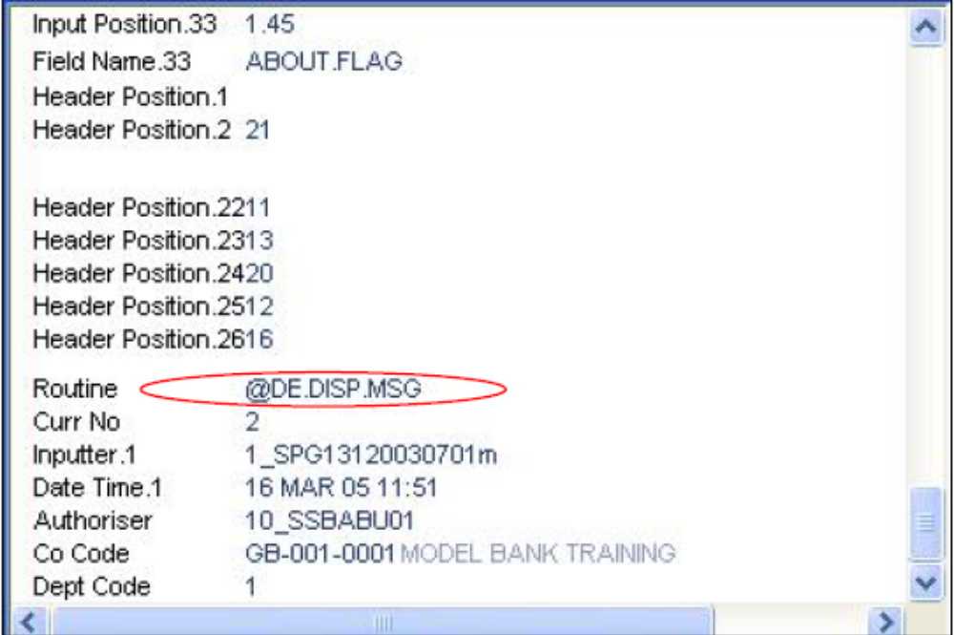
Delivery Routine
The routine is attached to the DE.MAPPING record and populates user defined information into the DE.O.HANDOFF (8-10th array)

Slide 5
Delivery Routine
Routine has 2 parameters
  The HANDOFF record
  Error Message Variable
New fields must be included
  DE.MESSAGE,
  DE.MAPPING
  DE.FORMAT.PRINT or SWIFT, depending on the carrier.

Slide 6
An Example
Ensure that, for all delivery messages of type 320 which are generated by the LD application when a deposit is made into a customer’s account contains the customer’s account officer name in the advice apart from the existing details.

Slide 7
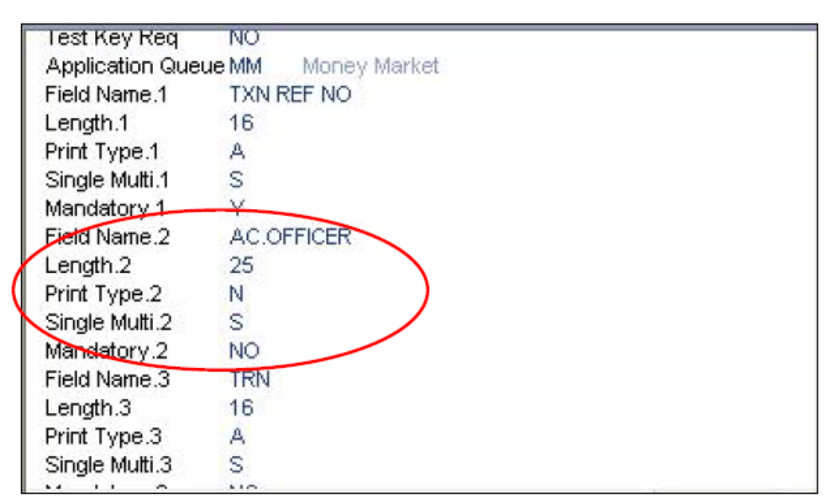
Solution to Example
Step 1 - Define the field in DE.MESSAGE

Slide 8
Solution to Example
Step 2 – Write the routine that will populate a position in the APPLICATION.HANDOFF with the required information
*Delivery routine that populates the APPLICATION.HANDOFF with
*the account officer of the customer who has taken a loan.
SUBROUTINE GET.ACCT.OFFICER(MAT HANDOFF.REC,ERR.MSG)
$INSERT I_COMMON
$INSERT I_EQUATE
$INSERT I_F.CUSTOMER
Y.CUS.ID = 0
R.CUS.REC = ‘’
FN.CUSTOMER = 'F.CUSTOMER'
F.CUSTOMER = ''
CALL OPF(FN.CUSTOMER,F.CUSTOMER)

Slide 9
Solution to Example
CUS.ID = HANDOFF.REC(2)<1>
CALL F.READ(FN.CUSTOMER,CUS.ID,R.CUST,F.CUSTOMER,ERR)
HANDOFF.REC(9)<2> = R.CUST<EB.CUS.ACCOUNT.OFFICER>
RETURN
END
  Information can be read from and written into the
  APPLICATION.HANDOFF array which is one of the
  parameters of the routine – HANDOFF.REC
Compile and Catalog the subroutine

Slide 10
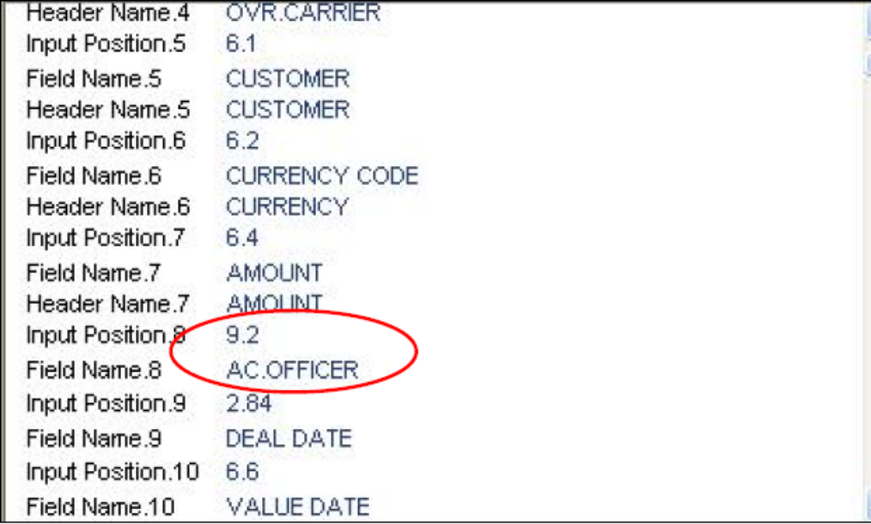
Solution to Example
Step 3 – Add new field to DE.MAPPING

Slide 11
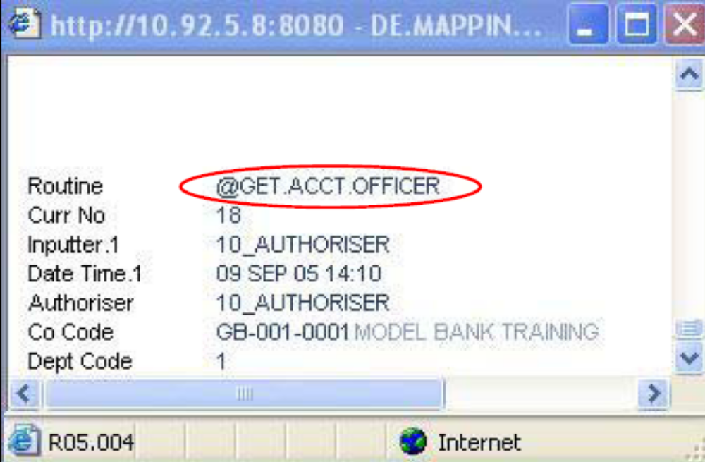
Solution to Example
Step 4 – Attach routine to DE.MAPPING

Slide 12
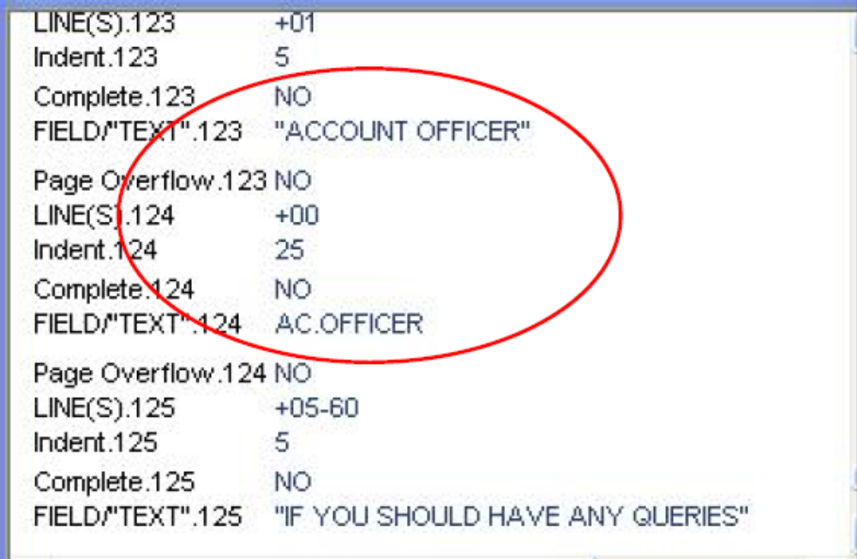
Solution to Example
Step 5 – Make required changes to the DE.FORMAT PRINT or SWIFT depending on the carrier

Slide 13
Solution to Example
Step 6 – Now produce the advice by inputting and authorising the transaction
Using the delivery reference, and the SEE.HANDOFF command at the jBASE prompt you can see the value populated by the routine in position 9.2 of the HANDOFF array

Slide 14
What You Have Learnt So Far
The need for Delivery routines
Writing Delivery routines
Using them in the Delivery applications

Slide 15


www.capgemini.com/financialservices
Notes:
© 2006 Capgemini - All rights reserved

